Slide 1


May 2-4, San Jose, California
Get the essential business and data analytics skills and technologies to stay ahead of the curve
Uncover new information and value to remain competitive
4 tracks designed to follow the Analyst’s Journey
Register at passbaconference.com today!
(Use discount code BAMARA for $100 off registration)
Notes:
If you like what you hear in these webinars, make sure to attend the PASS Business Analytics Conference taking place May 2-4 in San Jose, California. With hands-on learning opportunities from data and business analytics experts and a variety of networking opportunities, the PASS Business Analytics Conference is a great opportunity to gain valuable skills and advance your career.
All webinar registrants get $100 off the two-day pass. Just use discount code BAMARA during registration. Visit passbaconference.com to register today!

Slide 2

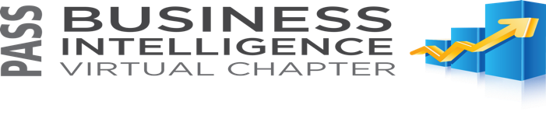
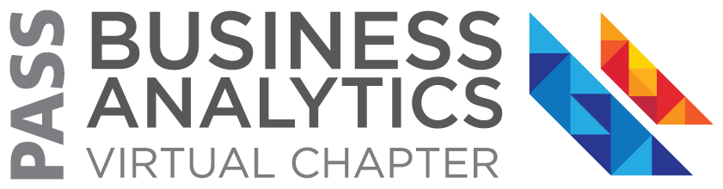

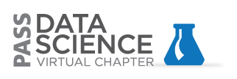
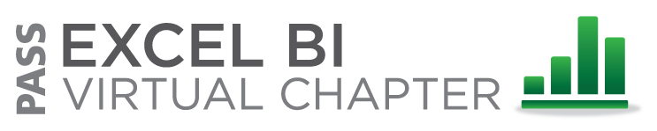
PASS Virtual Chapters for Business
Analytics www.sqlpass.org/vc
FREE ONLINE LEARNING
Notes:
If you are interested in accessing other free educational content, the PASS organization has a variety of Virtual Chapters which offer free webinars to their members every month. Check out upcoming webinars, and recordings of past webinars, from our Business Analytics, Excel BI, Business Intelligence, Big Data and Cloud Virtual Chapters by visiting www.sqlpass.org/vc

Slide 3
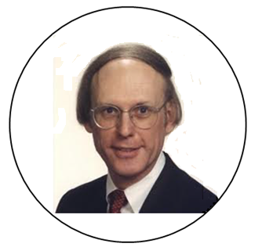



DANIEL FYLSTRA
President of Frontline Systems
Developer of Solver in Excel
25 Years in Advanced Analytics
  Data/Text Mining - XLMiner
  Optimization – Premium Solver
  Simulation – Risk Solver
Marketer of VisiCalc, the First
Spreadsheet on Apple II
www.facebook.com/FrontlineSolvers
twitter.com/FrontlineSolver
www.linkedin.com/company/frontline-systems-inc

Slide 4
Advanced Analytics for Excel Users: Learn How to Do It Yourself
Daniel Fylstra, Frontline Systems

Slide 5
Goals for Today’s Session
Know how Analytics builds on Business Intelligence
Know why you’d build an analytic model: business payoffs
Know what kinds of results you can get from analytic models
Know how you’d build your own analytic model, and how
to get data into your model
Know what to do next, if you want to learn

Slide 6
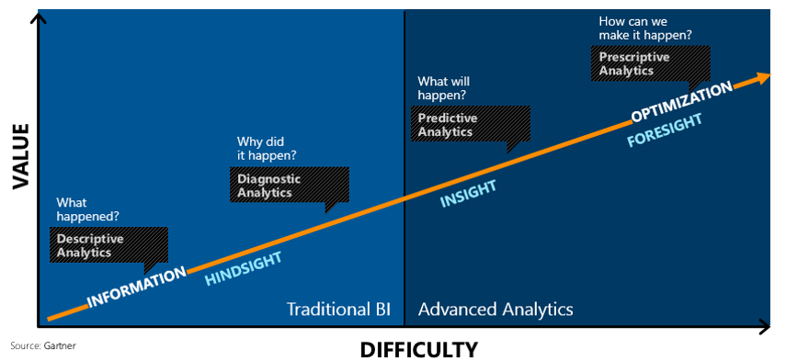
How Analytics Builds on Business Intelligence
“Analytics are a subset of … business intelligence: a set of technologies and processes that use data to understand business performance … The questions that analytics can answer represent the higher-value and more proactive end of this spectrum.” – Tom Davenport, Competing on Analytics

Slide 7
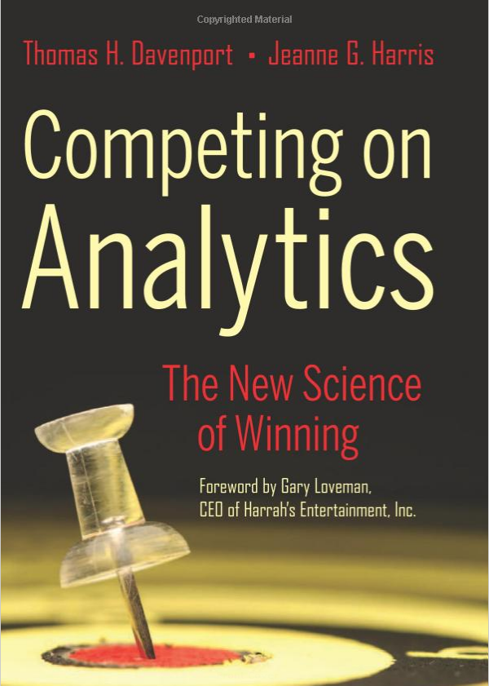
Analytics: The Three Levels
Descriptive Analytics: Classic BI
  Quantitative Assessment of Past Business Results
  Statistics, Exploratory Data Analysis, Visualization
Predictive Analytics
  Quantitative Methods to Predict New Outcomes
  Forecasting, Prediction, Classification, Association
Prescriptive Analytics
  Quantitative Methods to Make Better Decisions
  Decision Trees, Monte Carlo Simulation, Optimization

Slide 8

Why Build Analytic Models: Example Payoffs
Two Frontline Systems Customer Examples
  Excel model to optimally deploy 83 employees with different skill sets across 24 stations saved $1.9 million per year in overtime.
  Excel simulation model showed major chemical company why a plant was missing goals, and how to solve the problem without any new investment.
U.S. Air Force Air Logistics Center
  C-5 Galaxy transport maintenance hub reduced turnaround time from 360 to 160 days, saving taxpayers $50 million and saving soldiers’ lives.
Memorial Sloan-Kettering Cancer Center
  Optimizing radiation beams reduced side-effects of treating cancer – improving quality of life and saving $459 million per year on prostate cancer alone.

Slide 9
Can This Help in Your Work or Career?
Optimization models can deliver huge cost savings
Simulation/risk analysis models can help avoid disaster
But very few business analysts have the skills to do this
If you can do this, your value to your company will rise
Some analytic models address operations, others
address strategic decisions
  Ex. whether to build a new plant, and where to locate it
Be prepared to present your work to senior management

Slide 10
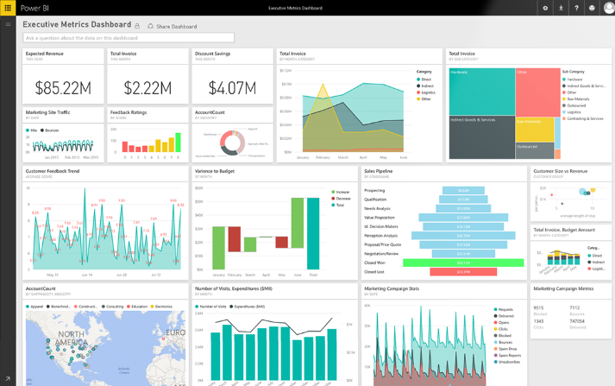
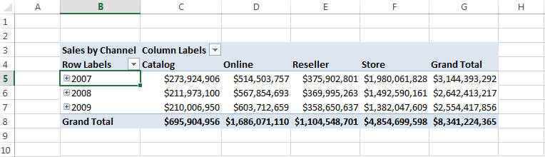
Descriptive Analytics: Excel & Power BI
Key task: Data access / shaping – Power Query does this
Excel + Power Pivot data model holds Past Business Results
Pivot charts, Power View, Power BI for data visualization
Formulas: Sum, Count, Average, Min, Max, Var, StdDev

Slide 11

Predictive Analytics: Data Mining
Key tasks: Data shaping, applying predictive models
Data mining algorithms “fit” analytic model to past data
Trained/fitted models are applied to newly arriving data
  Classify: ex. Good/Poor credit risk, Likely/Unlikely to churn
  Predict: ex. stock price, house price, exchange rate
  Forecast a time series: ex. next sales from past sales history
  Associate: ex. People who bought this item also bought...
Tools: Azure ML, XLMiner, Predixion, SAS, SPSS, R, others

Slide 12
Prescriptive Analytics: Optimization, Simulation
Key task: Create a model – A person (you) must do this
  Model must capture essential features of the business situation
  Larger models often get their data from BI / Descriptive Analytics
  A “What If” model is the starting point – Excel is a natural tool!
Given an appropriate model, we can:
  Ask “What are all the possible outcomes?” – simulation/risk analysis
  Ask “What’s the best outcome we can achieve?” – optimization
Tools: Solver, Risk Solver, @RISK, Crystal Ball, IBM, SAS, others

Slide 13
Results from an Analytic Model
Results from a data mining model:
  Tool to classify or predict outcomes for new cases
  Assessment of accuracy / predictive power
Results from a simulation model:
  Full range of outcomes and their likelihood
  Sensitivity analysis of input parameters vs. outcomes
Results from an optimization model:
  Best attainable objective, values for decision variables
  Sensitivity analysis of decision variables & constraints

Slide 14
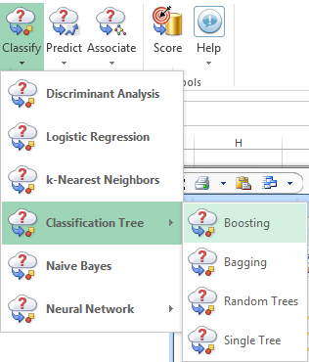
Data Mining: What You Need, How You Do It
What You Need: Tools to
  Access / shape data, explore / visualize data
  Train / “fit” models to data: machine learning
  Validate model results: statistics, Lift / ROC curves
How You Do It
  Data “wrangling” / cleaning is usually the first step
  Use feature selection to identify variables that matter
  Try multiple algorithms: Regression, trees, neural nets
  Assess and think about results: Avoid over-fitting

Slide 15
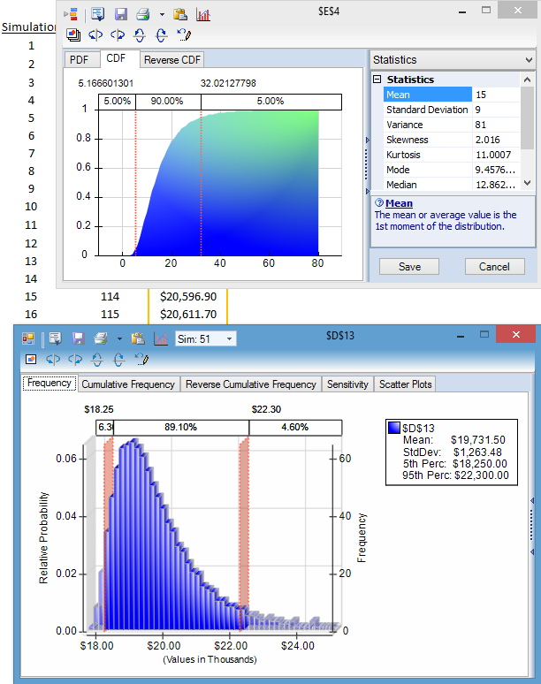
Simulation: What You Need, How You Do It
What You Need: Tools to
  Create a “what if” model, calculating results of interest
  Define probability distributions for uncertain inputs
  Run Monte Carlo simulation, create statistics and charts
How You Do It
  Define distributions by fitting data, or industry practice
  Define dependence among inputs: corr. matrices, copulas
  Run simulation, or multiple simulations with parameters
  Assess and think about results: stats, histograms, scatterplots

Slide 16
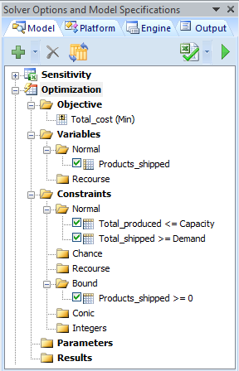
Optimization: What You Need, How You Do It
What You Need: Tools to
  Create a “what if” model, calculating results of interest
  Define decision variables for inputs under your control
  Define constraints and an objective to max / minimize
  Run an optimization for optimal values, sensitivity analysis
How You Do It
  Define constraints for limited resources, physical conditions, policies
  Understand dependence between outputs and inputs: linear / nonlinear
  Run optimization, or multiple optimizations with parameters you vary
  Assess and think about results: understand “dual values,” sensitivity

Slide 17
Can This Help in Your Work or Career?
Optimization models can deliver huge cost savings
Simulation/risk analysis models can help avoid disaster
But very few business analysts have the skills to do this
If you can do this, your value to your company will rise
Some analytic models address operations, others
address strategic decisions
  Ex. whether to build a new plant, and where to locate it
Be prepared to present your work to senior management

Slide 18
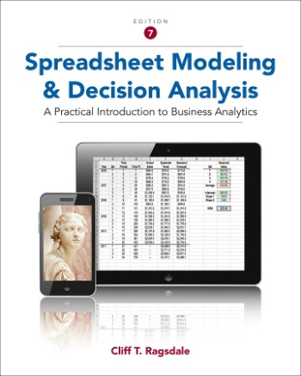
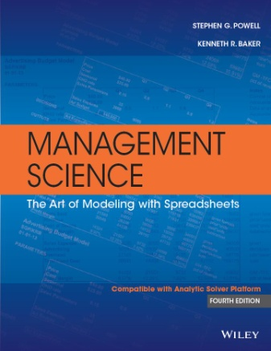
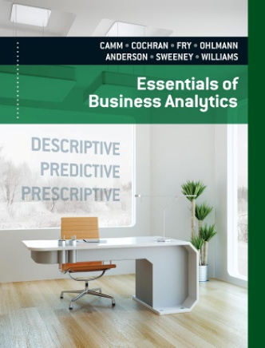
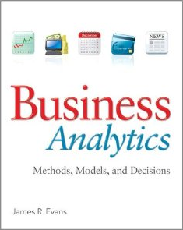
Where to Learn More: Textbooks on Amazon
Cliff Ragsdale Spreadsheet Modeling 7th Ed
Powell & Baker Management Science 4th Ed
Camm et al Essentials of Business Analytics
James Evans Business Analytics

Slide 19
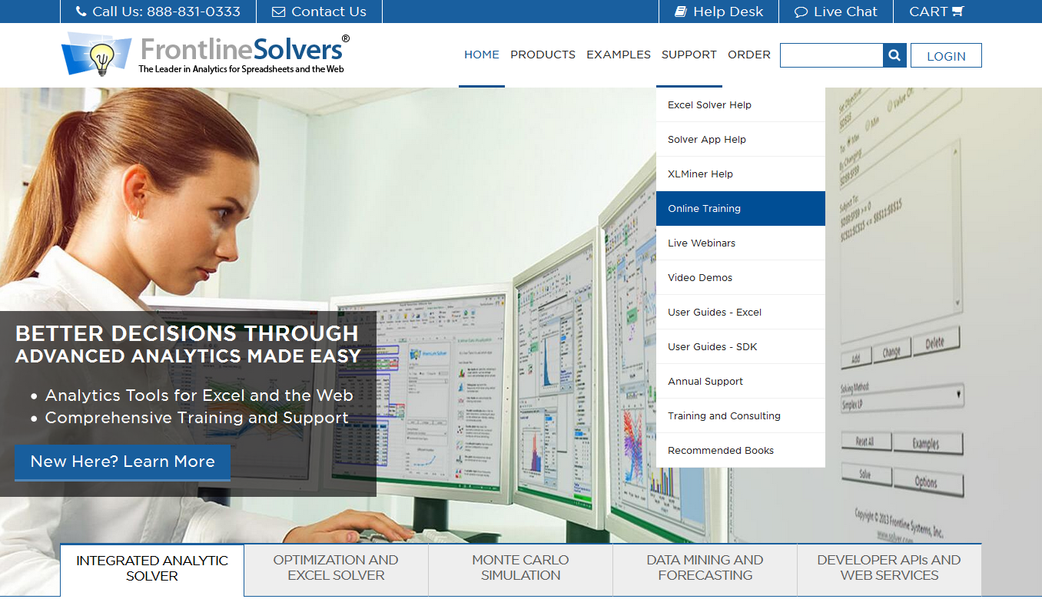
Where to Learn More: Online Courses and Tools
www.edx.org
www.coursera.org
www.solver.com
www.xlminer.com

Slide 20
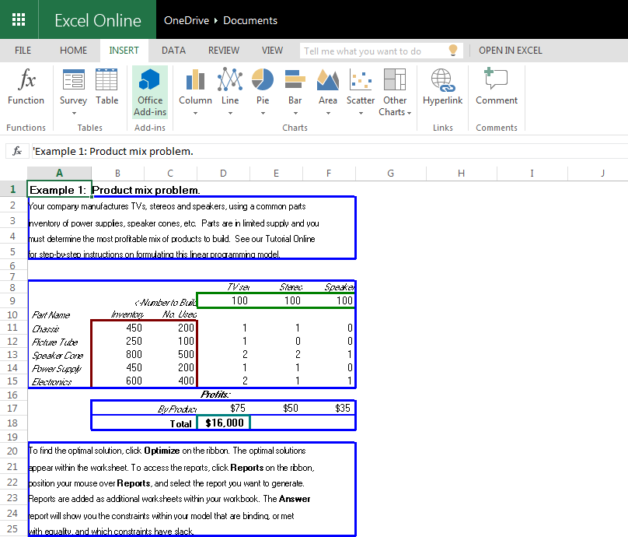
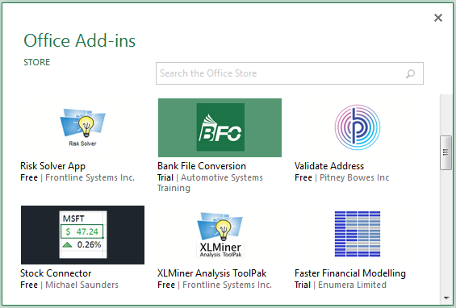
Free Tools to Get Started in Excel and Excel Online
Excel: Power Query, Power Pivot, Power View, Solver
Power BI: Free account, Power BI Designer
Excel Online Office Add-ins:
Solver, Risk Solver, XLMiner
XLMiner.com, Rason.com: Free accounts

Slide 21
Thank You –See You in San Jose!
Daniel Fylstra, Frontline Systems

Slide 22
Like What You Heard?
    Daniel Fylstra will be presenting at the
    PASS Business Analytics Conference 2016!
    Pre-Conference Session (full day)
    Advanced Analytics for Excel Users: Learn How to Do it Yourself
    Breakout Session (60 min)
    Prescriptive Analytics: Decision Models with Real Business Payoffs
Notes:
Like what you heard here?
Daniel will be presenting the pre-conference session Advanced Analytics for Excel Users: Learn How to Do it Yourself and the breakout session Prescriptive Analytics: Decision Models with Real Business Payoffs at the PASS Business Analytics Conference 2016.

Slide 23
JOIN
PASS
Access to online training and content
Enjoy discounted event rates
PASS is a not-for-profit organization which offers year-round learning opportunities to data professionals
Join Local Chapters and Virtual Chapters
Get advance notice of member exclusives
Membership is free, join today
at www.sqlpass.org
Notes:
This BA Marathon is brought to you by PASS, a not-for-profit organization which offers year-round learning opportunities to data professionals. If you’re not a member yet, join today, membership is free!

