Slide 1
Teaching Management Science in 2011
Use computer speakers or… Telephone: (312) 878-0211 Access Code: 206-468-740
If you don’t hear audio, open the panel in the upper right corner of your screen and check the audio settings. If on phone, try calling in again.
Using Spreadsheet Modeling and Decision Analysis 6th Ed. and Risk Solver Platform for Education Software
Cliff Ragsdale, Virginia Tech Daniel Fylstra, Frontline Systems Inc.

Slide 2
What We’ll Cover
What’s New in Spreadsheet Modeling and Decision Analysis 6e and Risk Solver Platform software
New Versions of Familiar Examples from SMDA 6e
Solver → Premium Solver → Risk Solver Platform
Impact of Windows 7, Excel 2010, Solver, 64-bits
RSP Student Licenses, IT/Faculty/Student Support
Your Questions on Any Part of This
Slides: solver.com/webinars/Ragsdale

Slide 3
Main Take-Away Messages
Change is Never Easy, but it’s Needed Now Because of PC/Software Changes in 2010
Frontline Systems and Ragsdale / Cengage Have Teamed Up to Provide a Better Solution
New RSPE – One Software Package – Replaces Premium Solver, Crystal Ball, TreePlan, DA Add-in to Simplify Teaching
Spreadsheet Modeling and Decision Analysis 6e Uses RSPE Software Throughout
Slides: solver.com/webinars/Ragsdale

Slide 4
How to Get the Textbook
Available now from Cengage
Printed / bound textbook, Instructor’s edition
Resource CD: PowerPoints, exercises, Test Bank
For a review copy, please:
Contact your Cengage rep (www.cengage.com/findrep.html)
Email esales@cengage.com
Slides: solver.com/webinars/Ragsdale

Slide 5
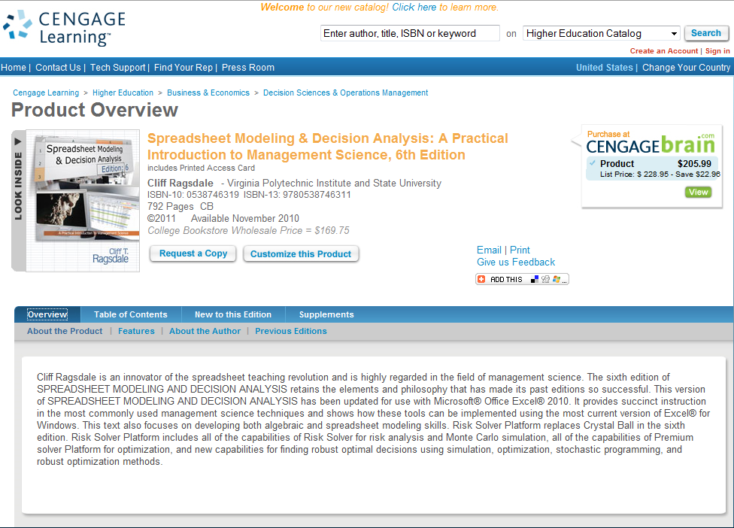
Slides: solver.com/webinars/Ragsdale

Slide 6
How to Get the Software
Available now at www.solver.com/student
Fill out the form to download the software
Use RSMDA6 for the Textbook Code
Use faculty for the Course Code
Run RSPSetup.exe to install the software
Use bestwaytoteach as the Password
Use 1702-0362-5214-4584 as the Activation Code (this will be emailed to you)
For a permanent RSPE license, please email Marc Kellison at marc@solver.com or call him at (775) 831-0300 x4
Slides: solver.com/webinars/Ragsdale

Slide 7
Risk Solver Platform for Education www.solver.com/rspe
Designed to Simplify Life for OR/MS Teachers, Save Classroom Time
With a Single, Supported Software Package:
Teach Linear/Integer, Nonlinear Optimization
Teach Simulation/Risk Analysis at Any Level
Teach Sensitivity Analysis, Decision Analysis
Teach Stochastic Optimization Far More Easily
Spreadsheet Modeling and Decision Analysis 6e Uses This Software Throughout
Slides: solver.com/webinars/Ragsdale

Slide 8
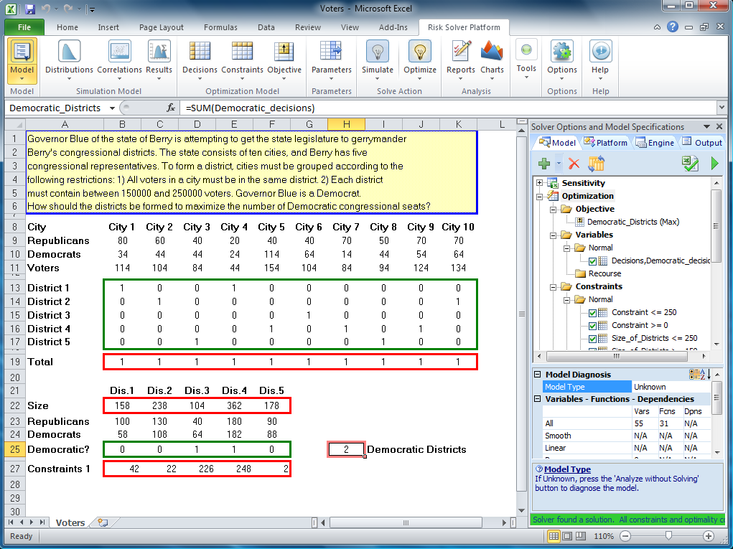
Risk Solver Platform Optimization
Slides: solver.com/webinars/Ragsdale

Slide 9
Risk Solver Platform for Education www.solver.com/rspe
Works with any recent Excel version
Accepts Models created in any Excel version
Runs Solver VBA Macros created in any version
Emulates both old and new (2010) Excel Solver dialog-based interface
New Ribbon-based interface and old dialog-based interface, synchronized at all times
Offers much greater optimization power than Solver or Premium Solver
Slides: solver.com/webinars/PowellBaker

Slide 10
Solver Subsets / Supersets
Risk Solver Platform
Premium Solver Platform
Premium Solver
Solver
Slides: solver.com/webinars/Ragsdale

Slide 11
RSPE in SMDA 6e
Ch 1-2: Introduction to Modeling & Optimization
Ch 3-4: Linear Programming & Sensitivity Analysis: LP/Quadratic Solver, Sensitivity Tools
Ch 5-7: Networks, Integer Programming, & Multi-Objective Optimization: LP/Quadratic Solver
Ch 8: Nonlinear & Evolutionary Optimization: GRG Nonlinear Solver, Evolutionary Optimizer
Slides: solver.com/webinars/Ragsdale

Slide 12
RSPE in SMDA 6e
Ch 9-11: Regression Analysis, Discriminant Analysis, & Time Series Analysis LP/Quadratic Solver, Discriminant Analysis Tool
Ch 12: Simulation Risk Solver & Simulation Optimization
Ch 13: Queuing Theory: LP/Quadratic Solver
Ch 14: Project Management: LP/Quadratic Solver, Risk Solver
Ch 15: Decision Analysis: Decision Tree, Sensitivity Tools
Slides: solver.com/webinars/Ragsdale

Slide 13
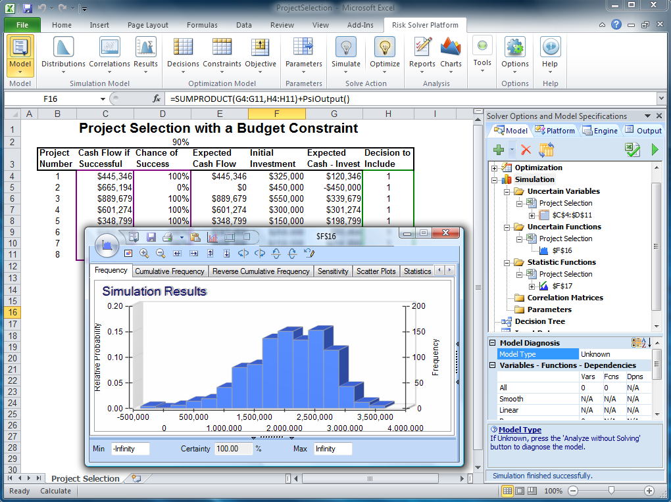
Risk Solver Platform Simulation
Slides: solver.com/webinars/Ragsdale

Slide 14
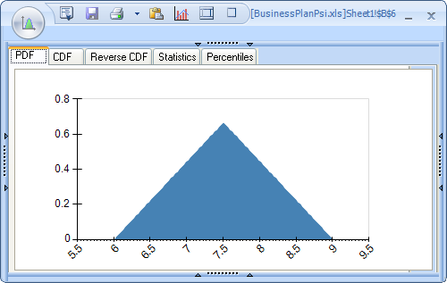
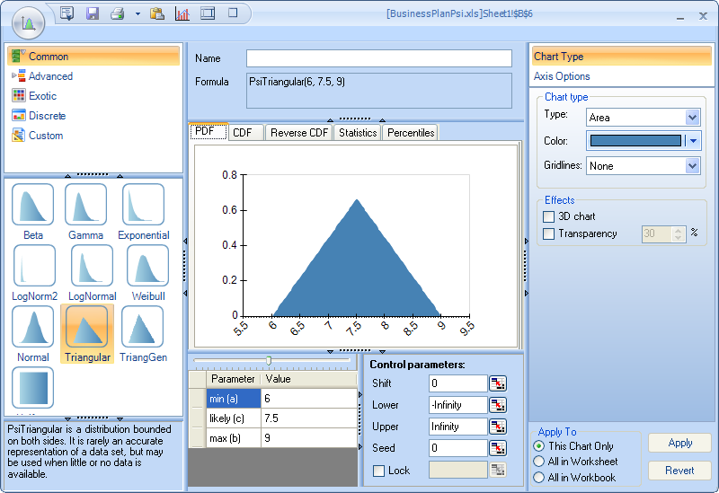
RSPE Monte Carlo Simulation
Select Distributions from Dropdown Gallery
Adjust Parameters, Shifting, Truncation
Display PDF, CDF, Statistics, Percentiles
Fit Distribution to User-Supplied Data
Rank-Order Correlation of Distributions

Slide 15
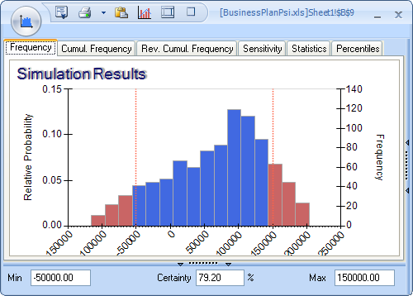
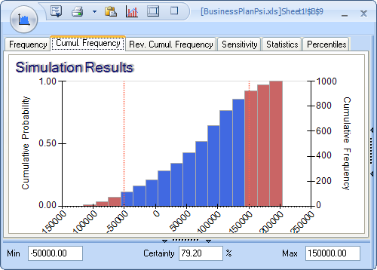
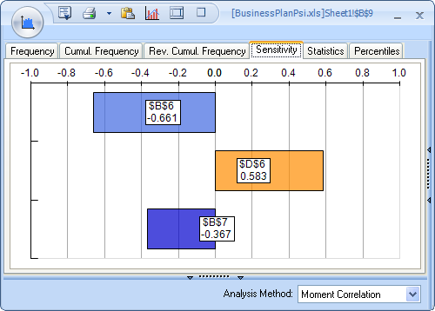
RSPE Monte Carlo Simulation
Select as Output or Reference in Statistic
Display Frequency, Sensitivity/Tornado Charts, Scatter Plots, Statistics, Percentiles
Fit Distribution to Simulation Results
Reports / Charts for Multiple, Parameterized Simulations
Slides: solver.com/webinars/Ragsdale

Slide 16
PC/Software Changes and RSPE
Windows 7 and Office 2010 are Mainstream (32-bit and 64-bit)
Excel 2010 Solver has New Capabilities and Changes in its User Interface
Add-Ins Designed for 32-bit Excel Won’t Work in 64-bit Excel 2010
Need and Opportunity for Change
Slides: solver.com/webinars/Ragsdale

Slide 17
Risk Solver Platform for Education www.solver.com/rspe
Designed to Simplify Life for OR/MS Teachers, Save Classroom Time
One Supported Software Package Covers All Main Management Science Methods
One User Interface for Optimization, Simulation, Etc.
Simplify the Transition to Excel 2010, New Solver, 64 Bits
Runs on Excel 2003/2007/2010, 32/64 Bits
Emulates old and new Solver as Transition Aid
Slides: solver.com/webinars/Ragsdale

Slide 18
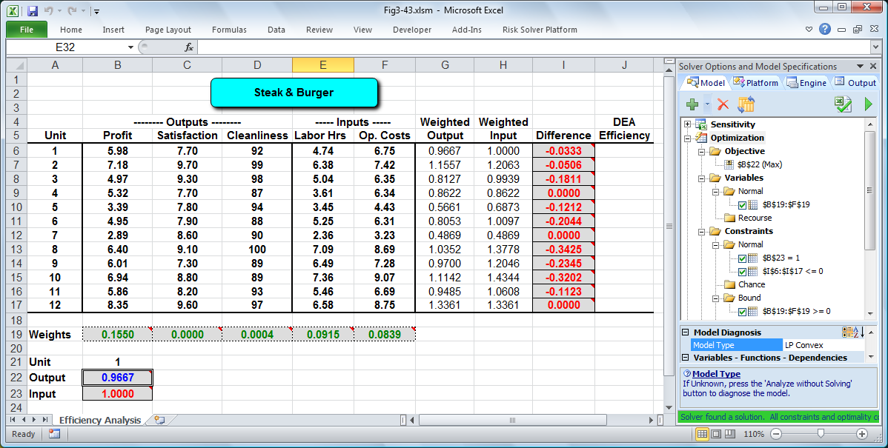
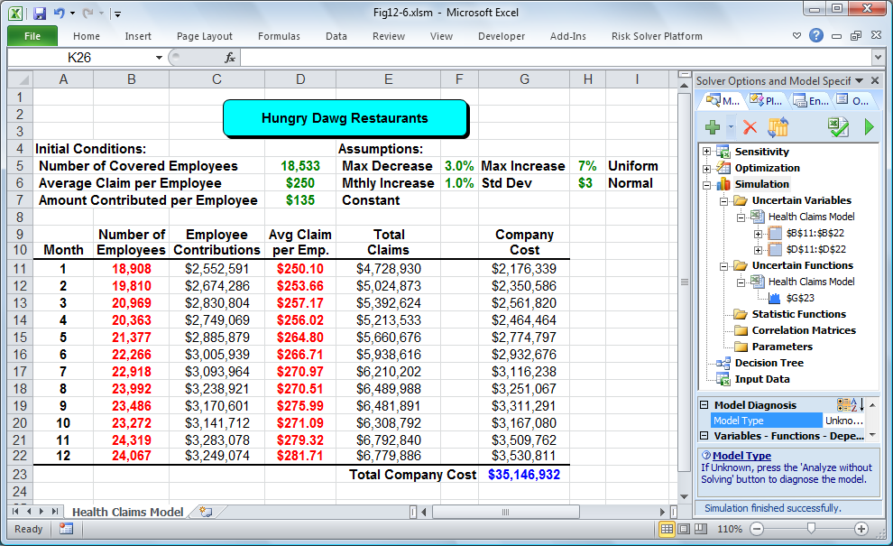
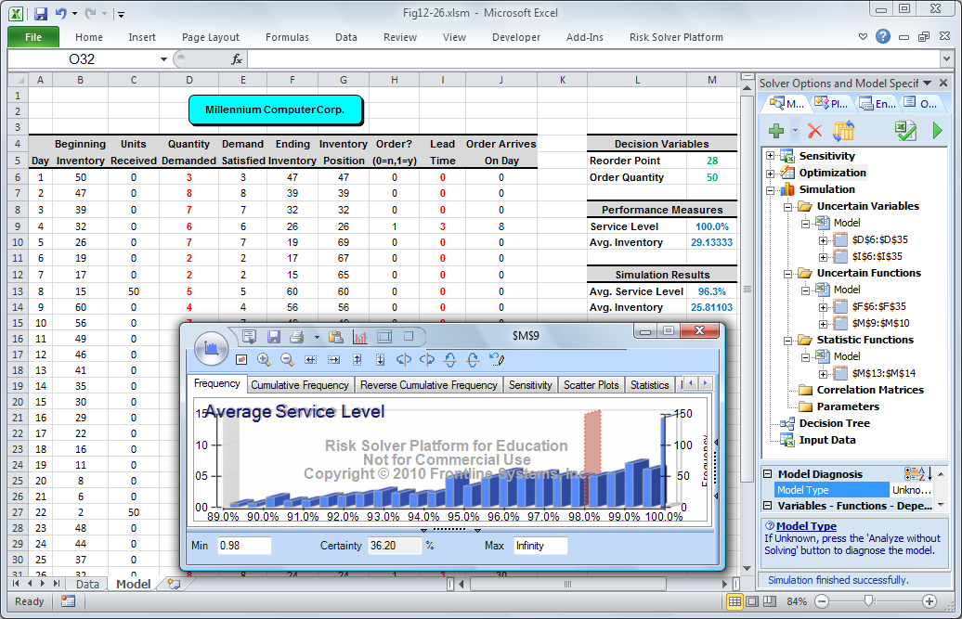
Using RSPE with SMDA 6e: New Versions of Familiar Models
Slides: solver.com/webinars/Ragsdale

Slide 19
Risk Solver Platform for Education www.solver.com/rspe
Focus on Models and Decisions – not just discrete topics of optimization and simulation
Show students how to use sensitivity analysis, simulation, optimization together
Show the unity of the methods: simulation + linear programming for stochastic optimization
Slides: solver.com/webinars/Ragsdale

Slide 20
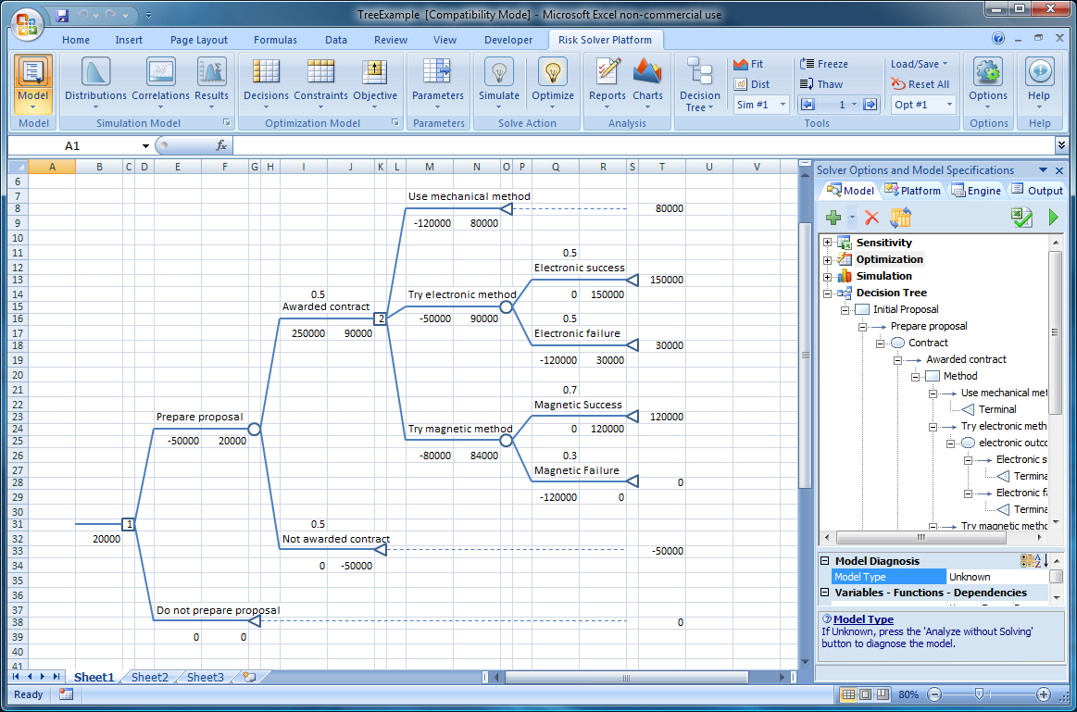
RSPE Decision Trees
Slides: solver.com/webinars/Ragsdale

Slide 21
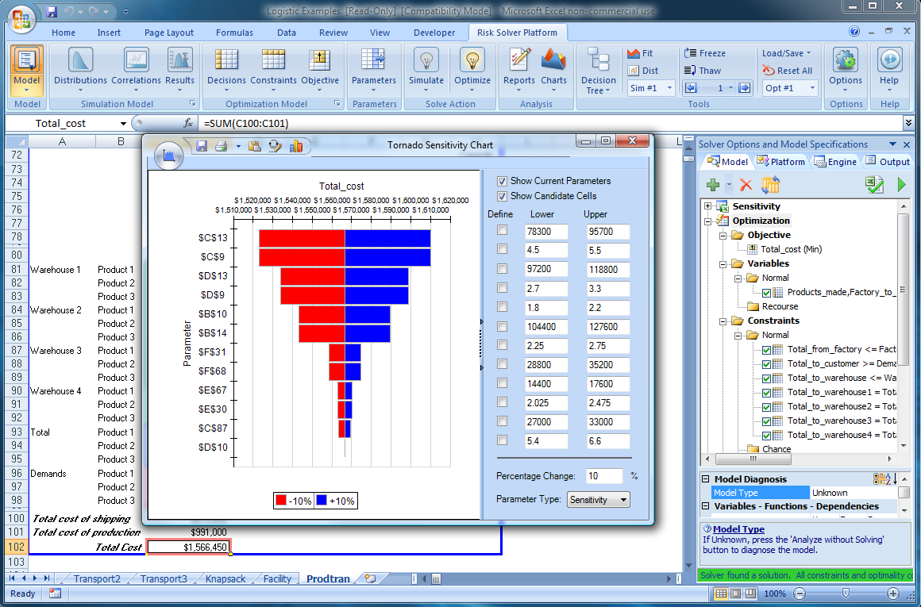
RSPE Sensitivity Analysis
Slides: solver.com/webinars/Ragsdale

Slide 22
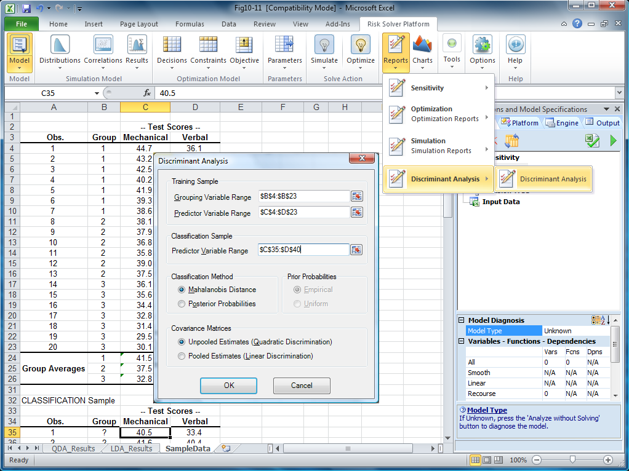
RSPE Discriminant Analysis
Slides: solver.com/webinars/Ragsdale

Slide 23
Risk Solver Platform for Education www.solver.com/rspe
More powerful optimization, automatic model diagnosis – from Premium Solver Platform
Full-featured risk analysis and Monte Carlo simulation – from Risk Solver
Solve stochastic optimization models with uncertainty and recourse decisions
Sensitivity analysis and decision tree features
Gurobi Solver – Ultra-Fast LP/MIP Solver
Slides: solver.com/webinars/Ragsdale

Slide 24
Risk Solver Platform Licensing www.solver.com/rspe
Free permanent evaluation licenses for Instructors
Free semester-length licenses for Students using Ragsdale 6th Edition
$50 permanent licenses for Students and Student Lab machines – minimum 10, cheaper for 100+
Full features of $4,000 commercial product, but:
200 Decision Variables, 100 Nonlinear Constraints
100 Uncertain Variables, 50 Uncertain Functions
10 Simulations, 10,000 Monte Carlo Trials / Simulation
These Limits are Adjustable in the License Code
Background ‘Watermarks’ on all Charts
Gurobi Solver is the Only Plug-in Solver Engine
Slides: solver.com/webinars/Ragsdale

Slide 25
Risk Solver Platform Support www.solver.com/rspe
Priority technical support for University IT:
Licensing for lab machines, networks, imaged PCs
Contact Duane Lincoln at duane@solver.com
Priority technical support for Instructors
Installation technical support for Students
A strategic priority for Frontline Systems
Slides: solver.com/webinars/Ragsdale

Slide 26
How to Get the Software
Available now at www.solver.com/student
Fill out the form to download the software
Use RSMDA6 for the Textbook Code
Use faculty for the Course Code
Run RSPSetup.exe to install the software
Use bestwaytoteach as the Password
Use 1702-0362-5214-4584 as the Activation Code (this will be emailed to you)
For a permanent RSPE license, please email Marc Kellison at marc@solver.com or call him at (775) 831-0300 x4
Slides: solver.com/webinars/Ragsdale

Slide 27
How to Get the Textbook
Available now from Cengage
Printed / bound textbook, Instructor’s edition
Resource CD: PowerPoints, exercises, Test Bank
For a review copy, please:
Contact your Cengage rep (www.cengage.com/findrep.html)
Email esales@cengage.com
Slides: solver.com/webinars/Ragsdale

Slide 28

Risk Solver Platform Contact Us for More Information
Frontline Systems, Inc. Incline Village, Nevada, US
Email info@solver.com Web www.solver.com
Toll-Free (888) 831-0333 Tel (775) 831-0300 Fax (775) 831-0314

